Slide 1
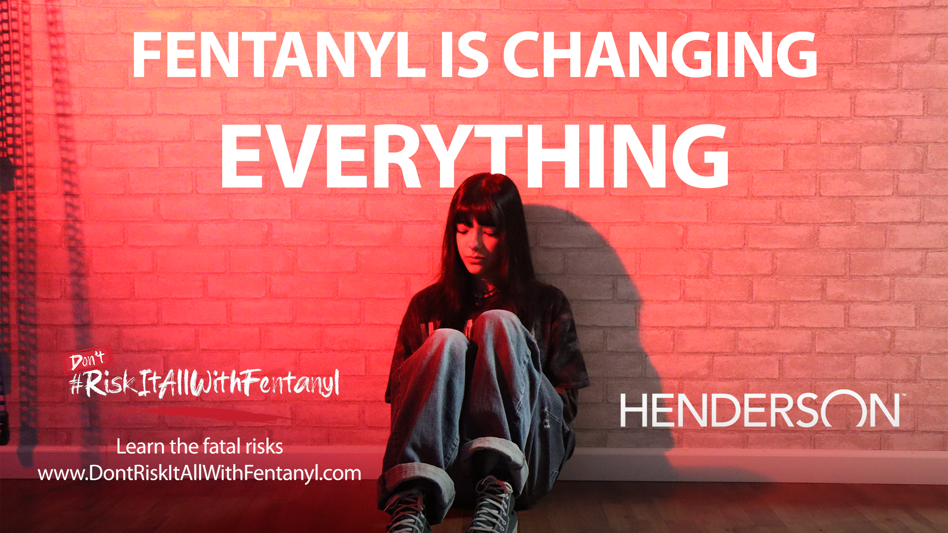

Slide 2

Train the Trainer Guide
Welcome to the "Train the Trainer" guide for the #RiskItAllWithFentanyl Awareness Campaign!
This guide is specifically tailored to equip you with the necessary knowledge and skills to effectively educate kids about the dangers and risks associated with fentanyl, a potent synthetic opioid that is increasingly causing deaths in our youth.
By becoming a trained facilitator, you can make a significant impact in raising awareness, preventing fentanyl-related harm, and saving lives.

Slide 3
Train the Trainer Guide
This guide explains what fentanyl is, why there is such an alarming rise in fentanyl-related overdoses and how we can work with our youth to ensure their safety.
Furthermore, we will share with you the #RiskItAllWithFentanyl campaign created by the City of Henderson that is geared directly to our kids – to ensure they understand that the landscape has changed, and one decision can be lethal.

Slide 4
Why is this important?
Opioid addiction is a public health crisis caused increasingly by the addition of Fentanyl to the illicit drug market.
Fentanyl has led to a 46 percent increase in deaths among Clark County residents and more than 225 deaths in 2021. It is 50-100 times more potent than morphine and heroin!
Increasingly, we are seeing deaths among young people. And unlike most opiates, Fentanyl can be lethal with the first use. It only takes a two-milligram dose, similar to 5-7 grains of salt to cause death for an average size adult.
You can’t taste, smell or see the difference between fake pills laced with deadly Fentanyl and the real thing.
The City of Henderson desires to focus its efforts on middle school and high school-age children because youth at this age have a natural propensity to experiment, the same as every generation before them.
However, the danger of this drug makes one choice potentially lethal.

Slide 5
Why is this important?
Fentanyl is being added to almost every pill conceivable, creating fake ones with the same texture, smell and taste as the original pill. Illicit drug manufacturers are even counterfeiting everyday medicines like Tylenol and Ritalin.
And predominantly, dealers are connecting with kids on social media.
So that is where we want this campaign to show up – so hopefully we can let them know the dangers before they try it “just this one time.”
The landscape has changed. And kids of every background, zip code and socio-economic class are dying from this lethal drug.

Slide 6
What do we need from you?
Our ask to you is simple.
Share the facts.
Drive kids to the campaign.
We know kids this age will listen to their peers much more than they do adults.
Our hope is that this session will start that conversation.

Slide 7
Presentation to Youth
The campaign approach came out conversations with local kids ages 12-18. We took the time to share other campaigns from around the country to a variety of groups in Henderson and asked them what resonated.
So, you will see three different executions of the campaign based on that feedback:
Some kids reacted strongly to a highly cinematic approach with dramatic music and high-quality graphics. (See Fentanyl Is Changing Everything ads in the #RiskItAllWithFentanyl toolkit.)
Others asked us to just “give it to them straight” with a more direct fact-driven approach (See It Only Takes Once ads)
Almost every young person we talked to was emotionally drawn in and felt they could really relate to a personal story from someone their age who had experienced a loss (See I Miss Him ads. Valentina is a Green Valley HS student).

Slide 8
Presentation to Youth
Contained in this kit is a suggested presentation and script (in notes section below each slide).
But you know your kids better than we do, so please feel free to customize as you see fit.
Just remember to give them all the information contained herein so we can educate them to the fullest extent possible.
Thank you for taking the time to learn about this crisis, and importantly, for helping us connect with the youth of our community.

Slide 9
Notes:
Thank you for joining us today as we discuss a really important topic.
Who here today has heard of Fentanyl? (Show of hands)
For those who have, what do you know about it?
Does anyone have personal experience with this they would be willing to share?
Has anyone been offered something via social media or witnessed someone else being offered something that could be potentially dangerous?
(Allow discussion – validate accurate information, let them know we will go into more depth on topics, as needed)
Thank you for sharing and being so raw and honest.

Slide 10

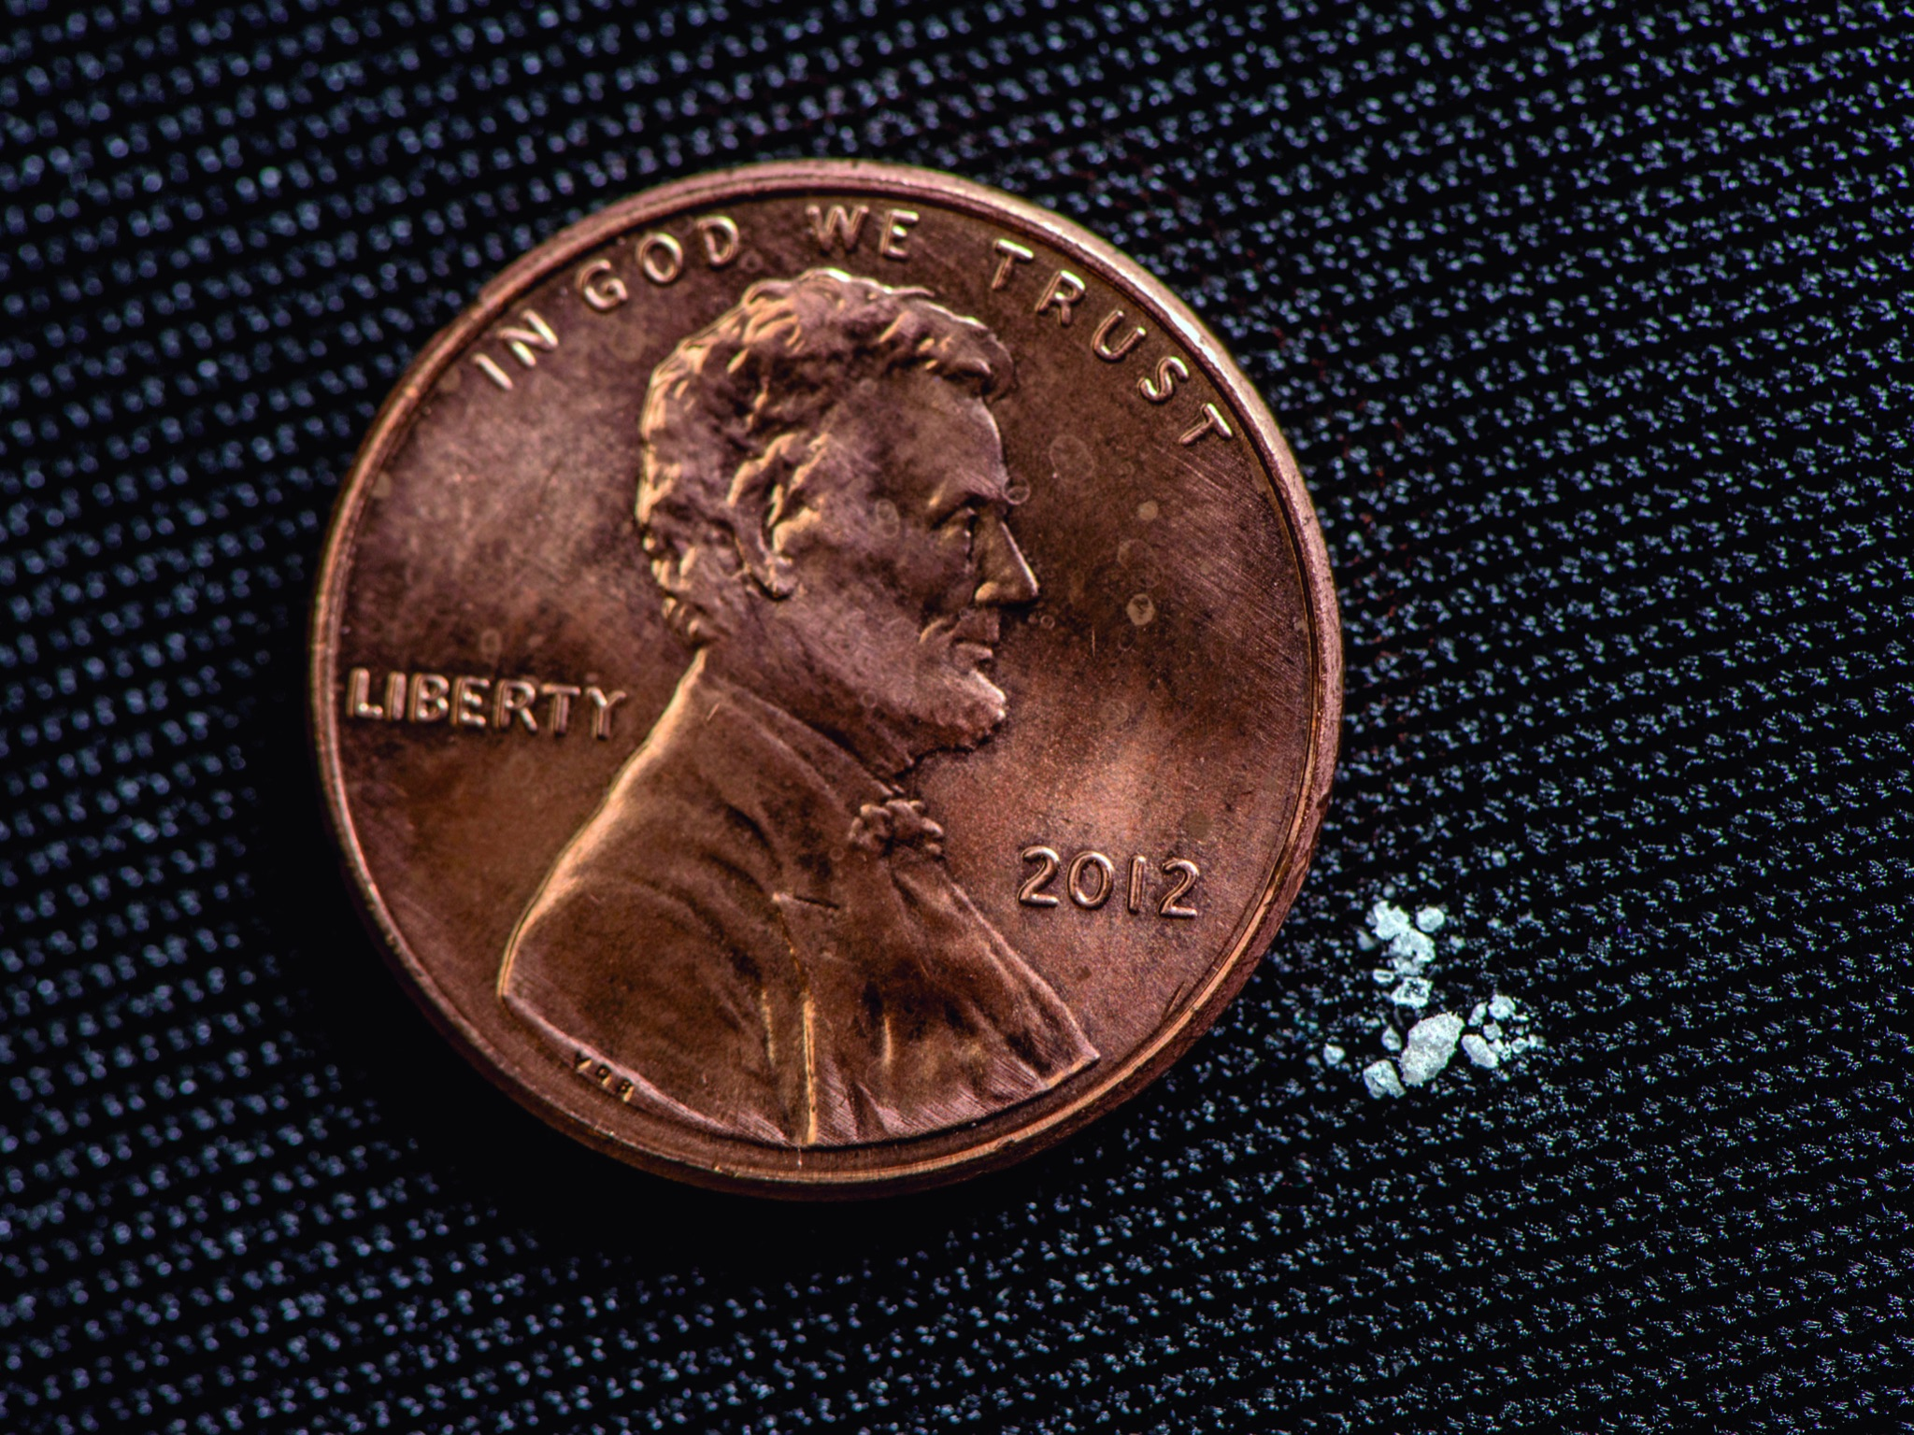
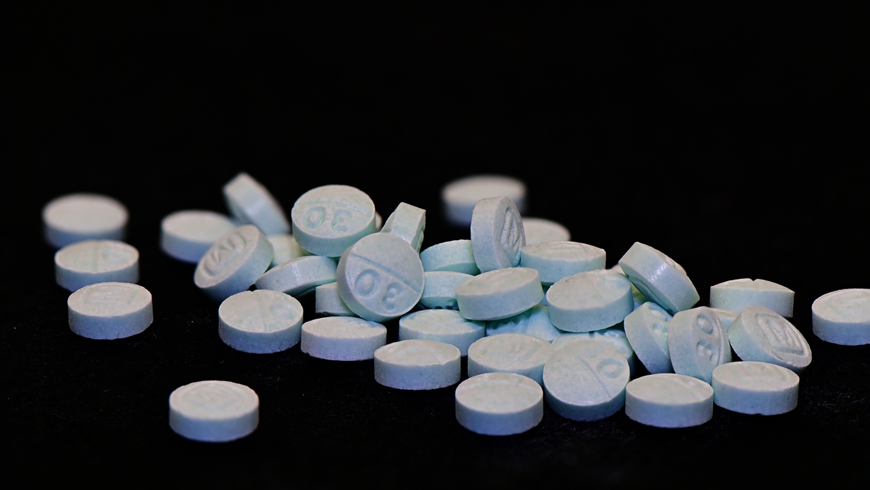
What is Fentanyl?
Notes:
First, it is important that you know that Fentanyl is creating a crisis all over the country – and especially right here in our community.
Fentanyl is a synthetic drug, originally made to treat pain. But today, it is being laced – mainly by the Mexican drug cartels - into other drugs and being sold to people without them knowing what is in it. It is super easy and really inexpensive for them to make, so it is very profitable for them.
Last year, enough drugs laced with Fentanyl were seized by law enforcement to kill every American citizen. Think about that!
Fifty to 100-times more potent than morphine, Fentanyl-laced drugs have led to a 46 percent increase in deaths among people right here in Southern Nevada – in your own backyard.
Sadly, we are seeing more and more deaths among young people your age. And unlike most opiates, Fentanyl can be lethal with the first use. It only takes a two-milligram dose, similar to 5-7 grains of salt to cause death for an average size adult.

Slide 11
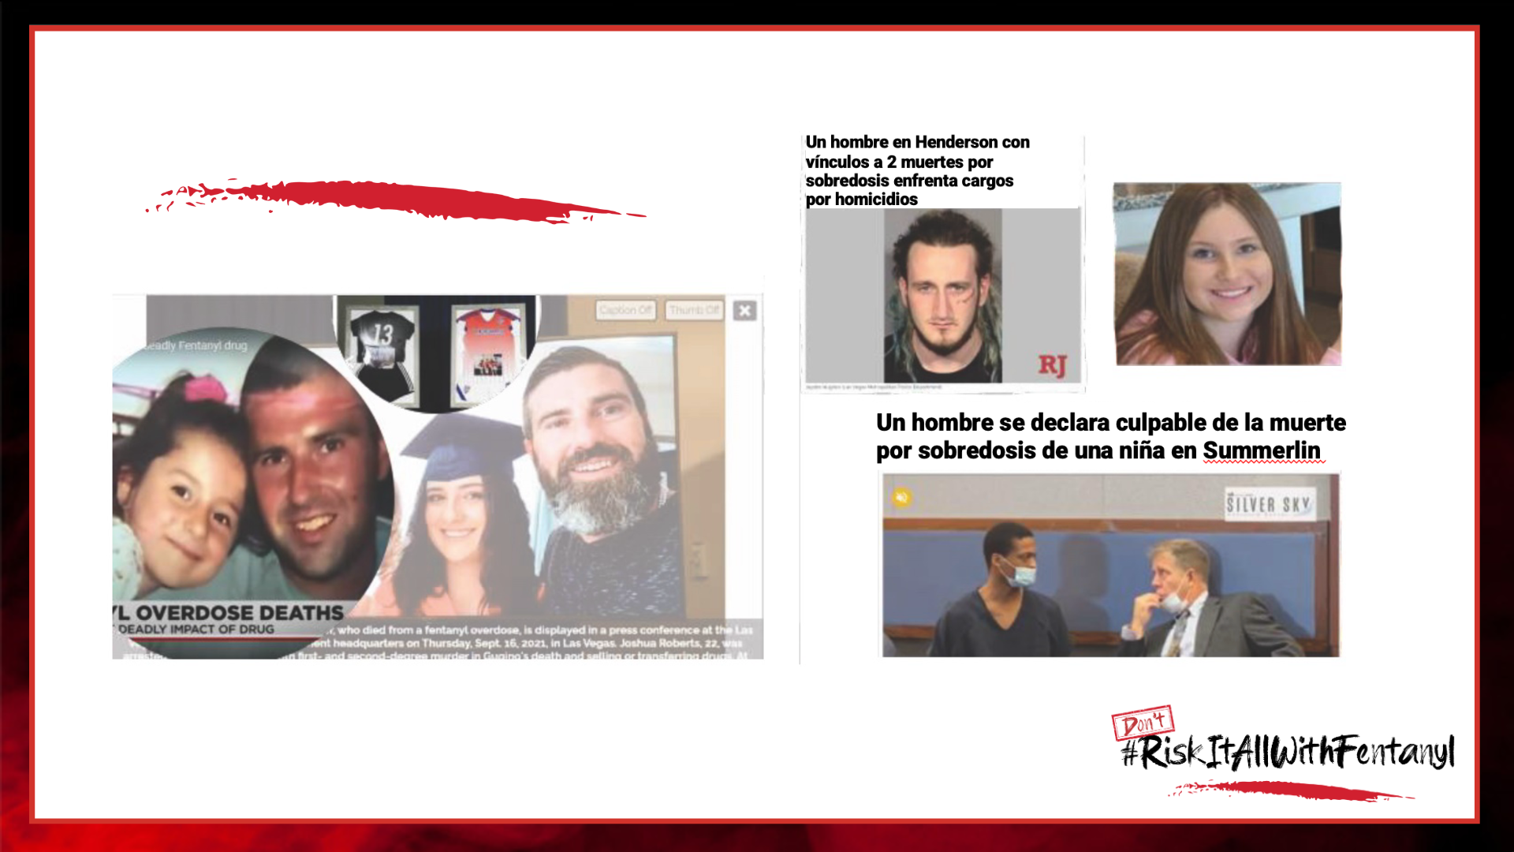
Local Headlines
Notes:
It's not just "troubled kids" who are dying - the all-too-frequent news stories show athletes, straight A students, band and drama kids losing their lives.
And it's not just happening in far-off places – high school and middle schoolers right here in Southern Nevada are affected too.
All of us were once your age – we get it.
You and your friends are likely to want to experiment – just like your parents did when they were young, and generations before them.
The problem is, the danger of this drug makes one choice potentially lethal.

Slide 12
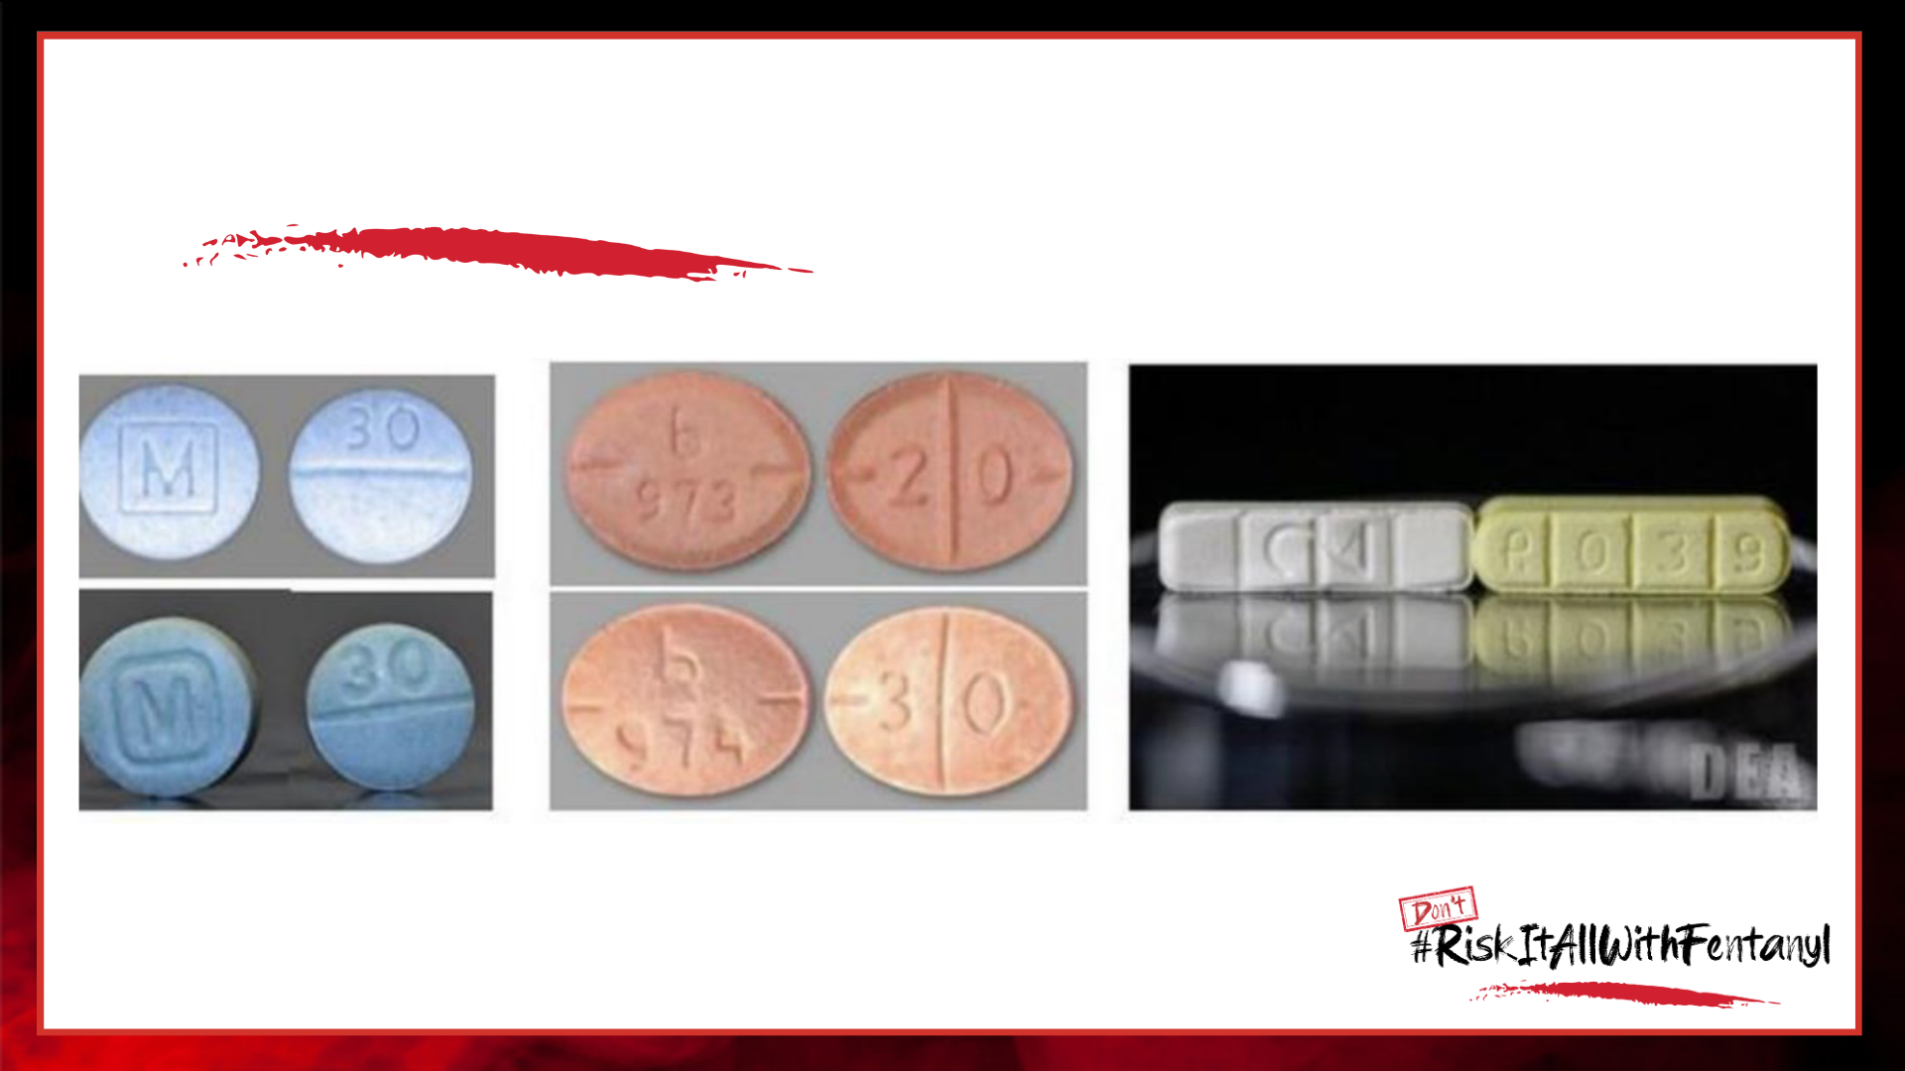
Can you tell the difference?
Notes:
Today Fentanyl is being added to almost every drug conceivable.
Street drugs like heroin and cocaine are being laced at an unimaginable rate.
Sitting here now, you might think “I’ll never take drugs, but this is a prescription pill – people take them all the time.”
The DEA estimates that 6 out of every 10 pills are fake pills laced with a lethal dose of Fentanyl. Even everyday medicines like Tylenol and Ritalin and other common drugs are being found laced with Fentanyl.
Fentanyl doesn’t change the texture, smell or taste of the pill or the powder. So, you won’t even know it’s in there until it’s too late.
Can you tell the difference?
Scary, huh!

Slide 13
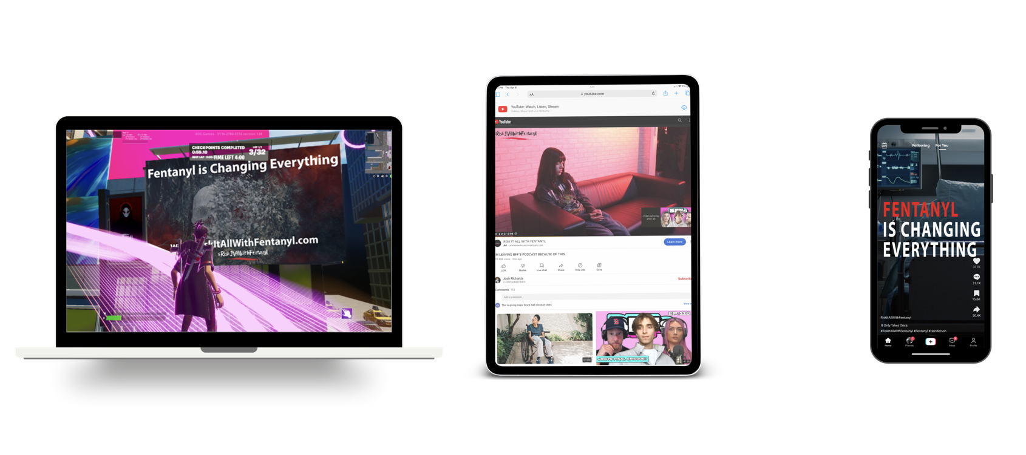
TT/YT/TikTok, YouTube and In Game Ads
Notes:
So, we feel it is really, really important that we do something to help you and your friends understand the danger that is out there.
Most often, kids are being sold these drugs through social media. People – dealers - approach them online or through apps – lure them into thinking they are getting coke, or ecstasy or some over-the-counter drug, but in reality, it has enough Fentanyl in it to kill them. The person who is selling it may not even know it is laced with Fentanyl!
So, a campaign has been developed that will primarily show up online through popular apps, games and websites frequented by kids your age. This campaign was developed after talking to lots of kids right here in Henderson.
What we heard from them is that there were three different approaches needed to capture their attention so hopefully they hear this information before it’s too late.

Slide 14
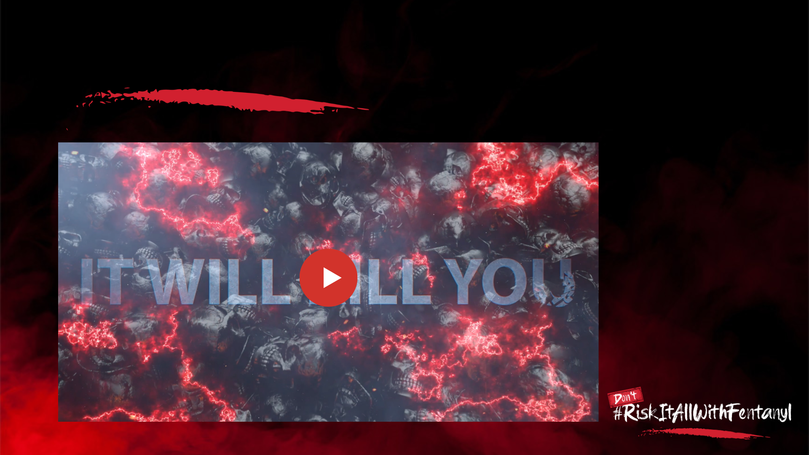
Fentanyl is Changing Everything Video
Notes:
Some kids wanted to see a cinematic approach with high-quality graphics and dramatic music.
PLAY "FENTANYL IS CHANGING EVERYTHING" VIDEO

Slide 15
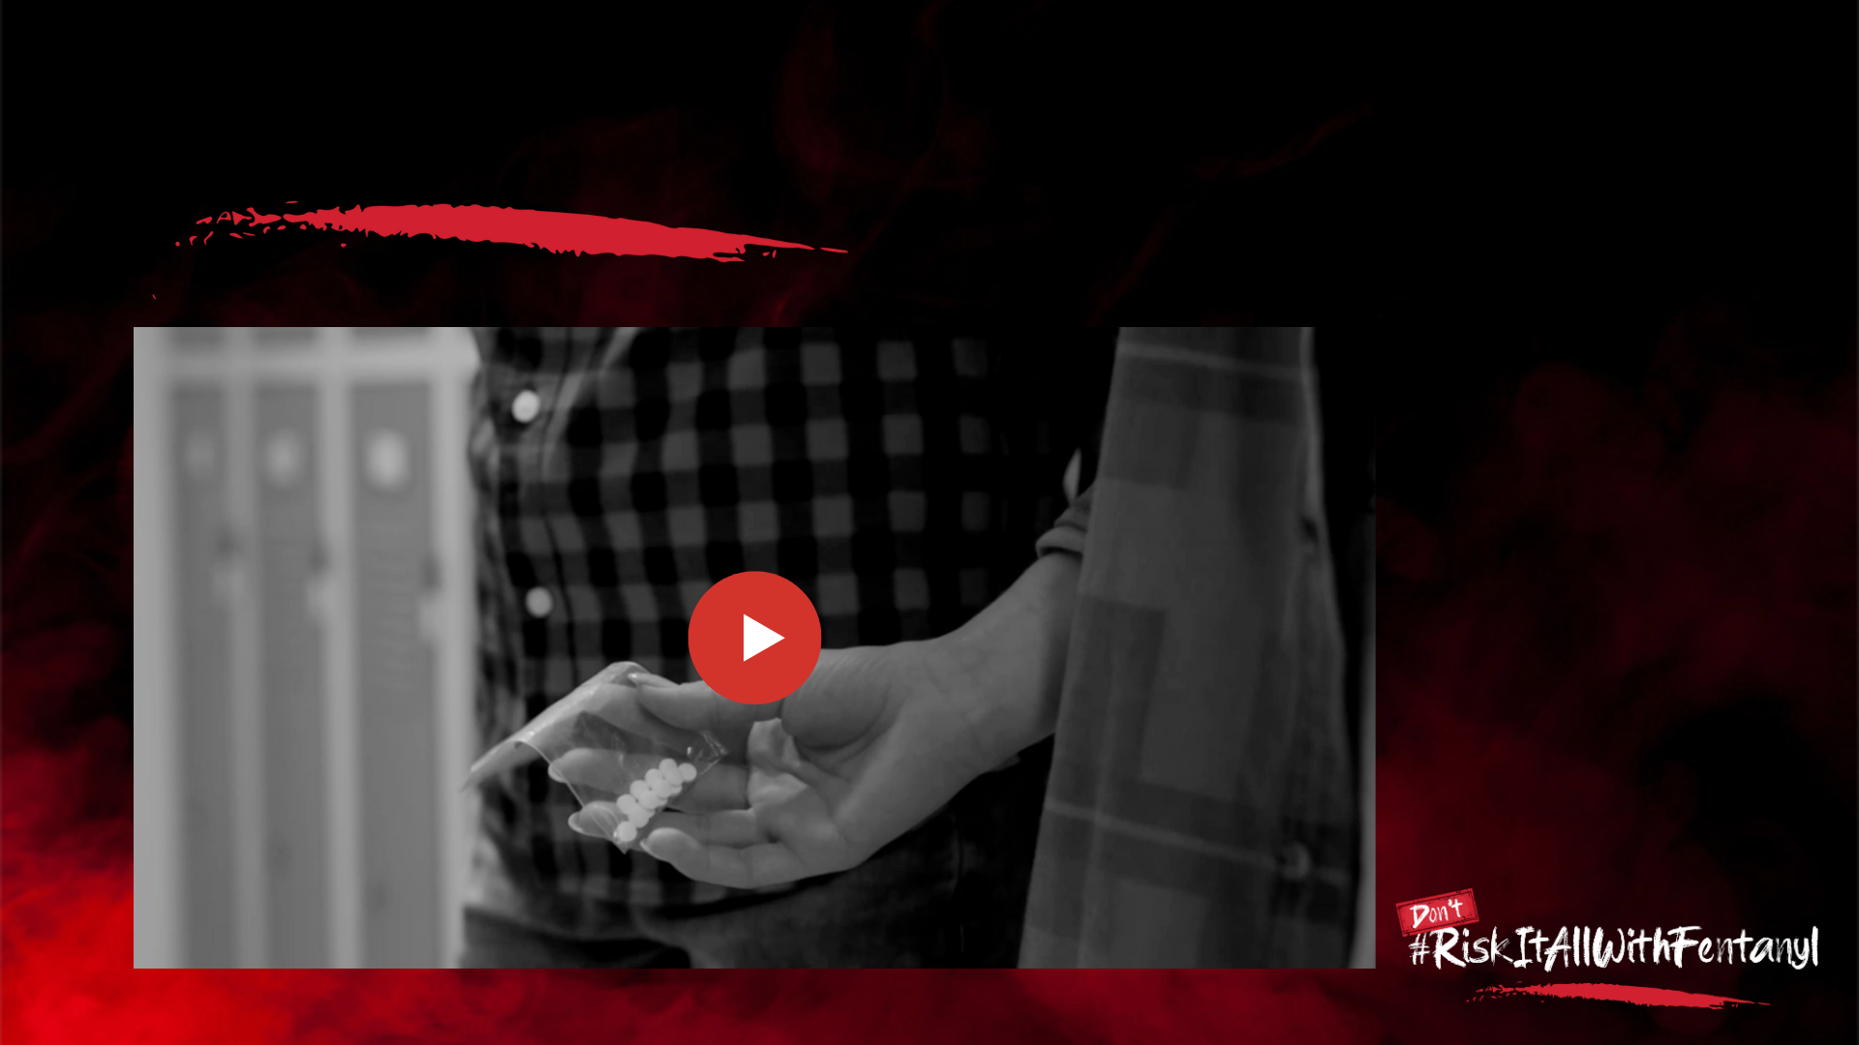
It Only Takes Once Video
Notes:
Other kids told us “Tell it to me straight – just give me the facts.”
PLAY “IT ONLY TAKES ONCE” VIDEO

Slide 16
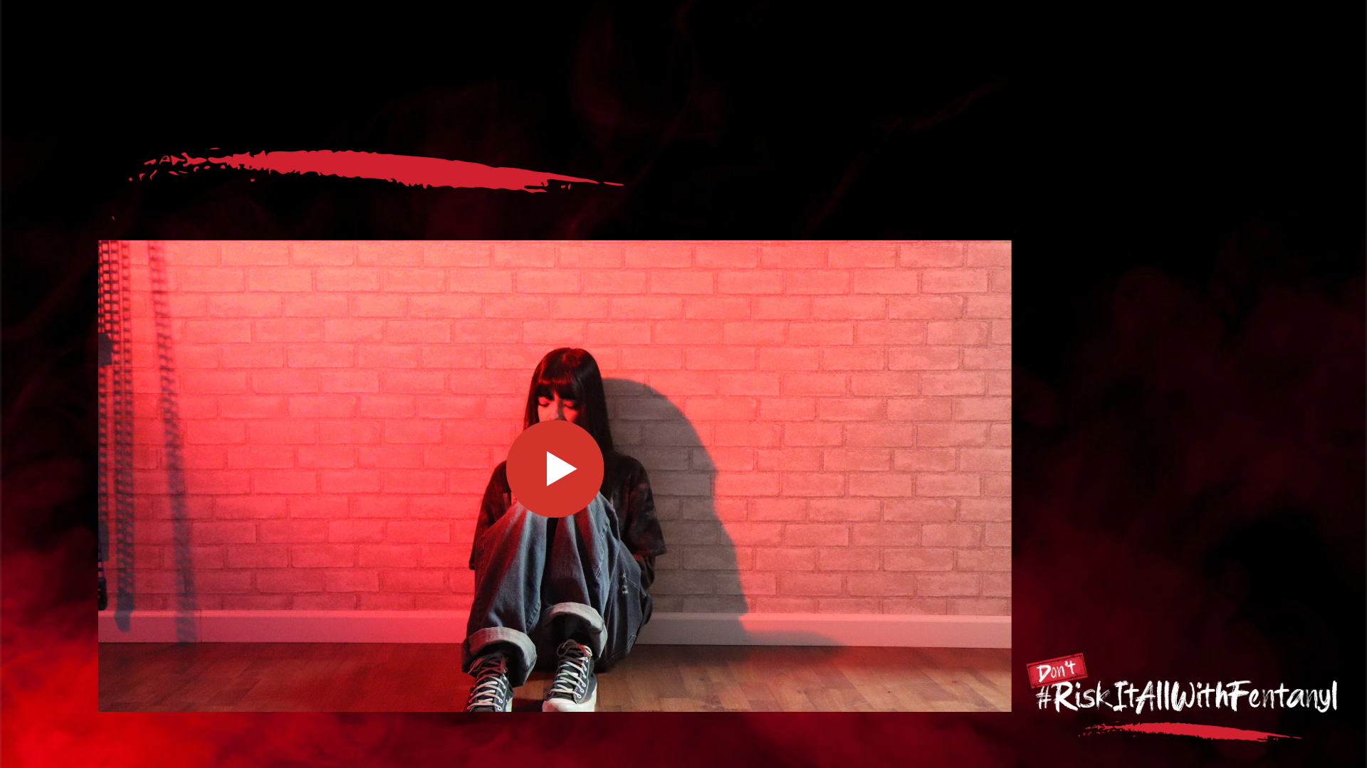
I Really Miss Him Video
Notes:
Almost everyone we talked to said they would be persuaded by someone local who had experienced a loss due to Fentanyl, someone their age to whom they could relate.
PLAY “I MISS HIM” VIDEO
What are your thoughts about what you have seen in these videos? (open discussion)

Slide 17
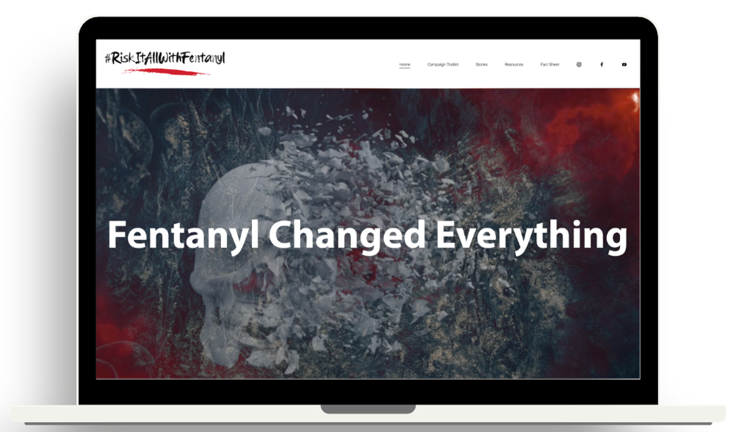
Website
Notes:
So, this is where we need your help.
In our focus groups, it became clear that kids in junior high and high school consider what they hear from their peers much more credible than anything they hear from adults (we actually already knew that 😊)
So, we are here today because we need your help in spreading this message.
We created a website that is directed to you and your friends – www.RiskItAllWithFentanyl.com.

Slide 18
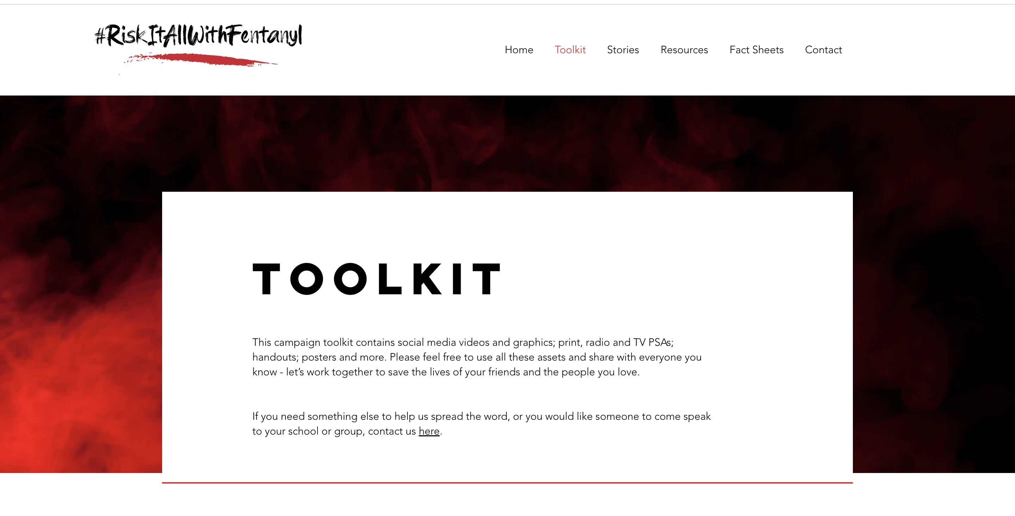
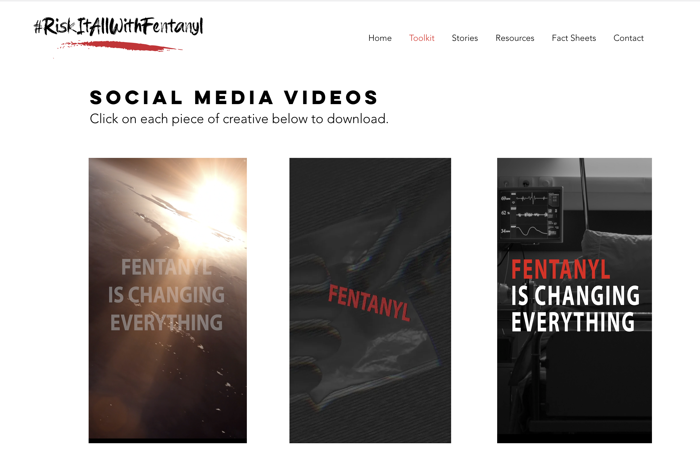
Toolkit
Notes:
On this website, we have a toolkit that contains the videos you just saw, as well as some that are sized for a variety of social media platforms.
There also are social media graphics, posters, fliers, even TV and radio spots and banner ads.
These are all available free to anyone who wants to use them.

Slide 19
How Can You Help?
Use the social media videos
Activate the campaign in your school, at your places of worship, with your sports team or other community group
        Posters
School TV/Newspaper/Morning Announcements
Student Club
Other Ideas?
Notes:
Here’s what we would love to ask you to do:
Use the provided social assets to share this super important message with your friends and social networks.
Think about how we can activate this campaign in your school, your places of worship, sports team or other community group.
Can we hang posters around?
Can we use the ads in your school TV or newspapers?
Is there a way to incorporate this campaign into a school assembly?
Is there a student club that would want to take up Fentanyl awareness as one of their service projects?
We are open to every idea you have.

Slide 20


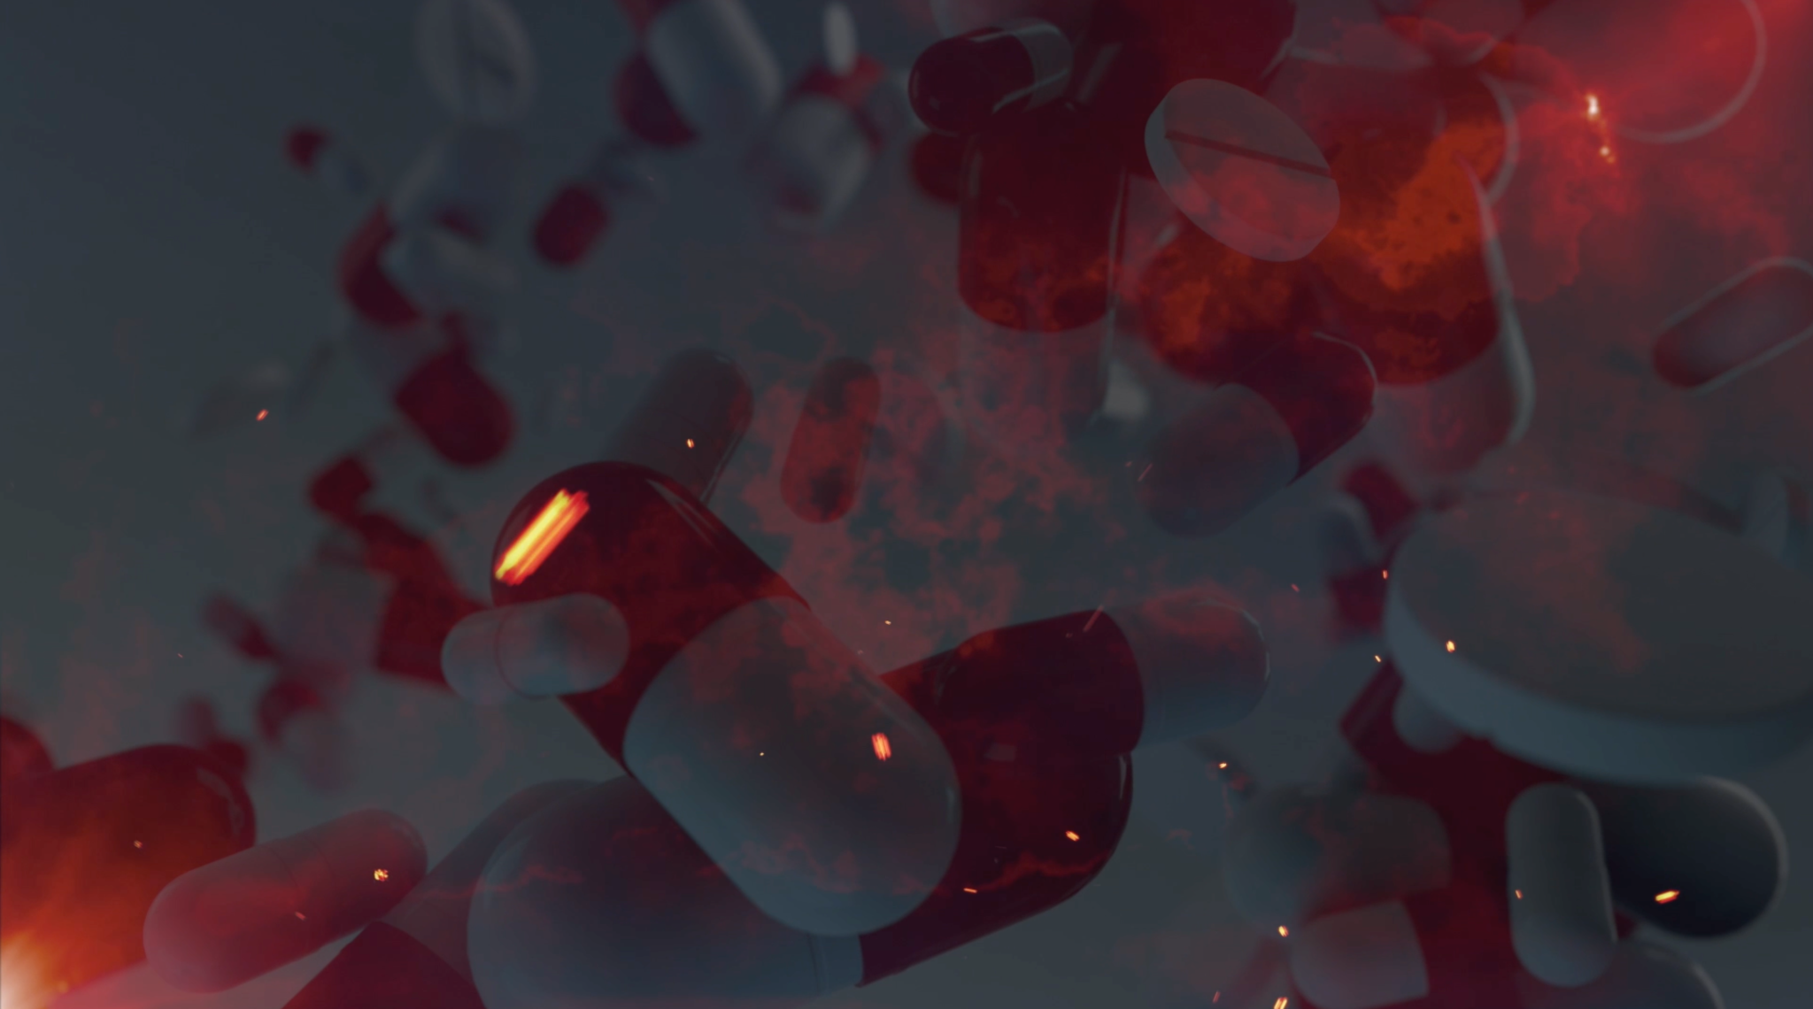
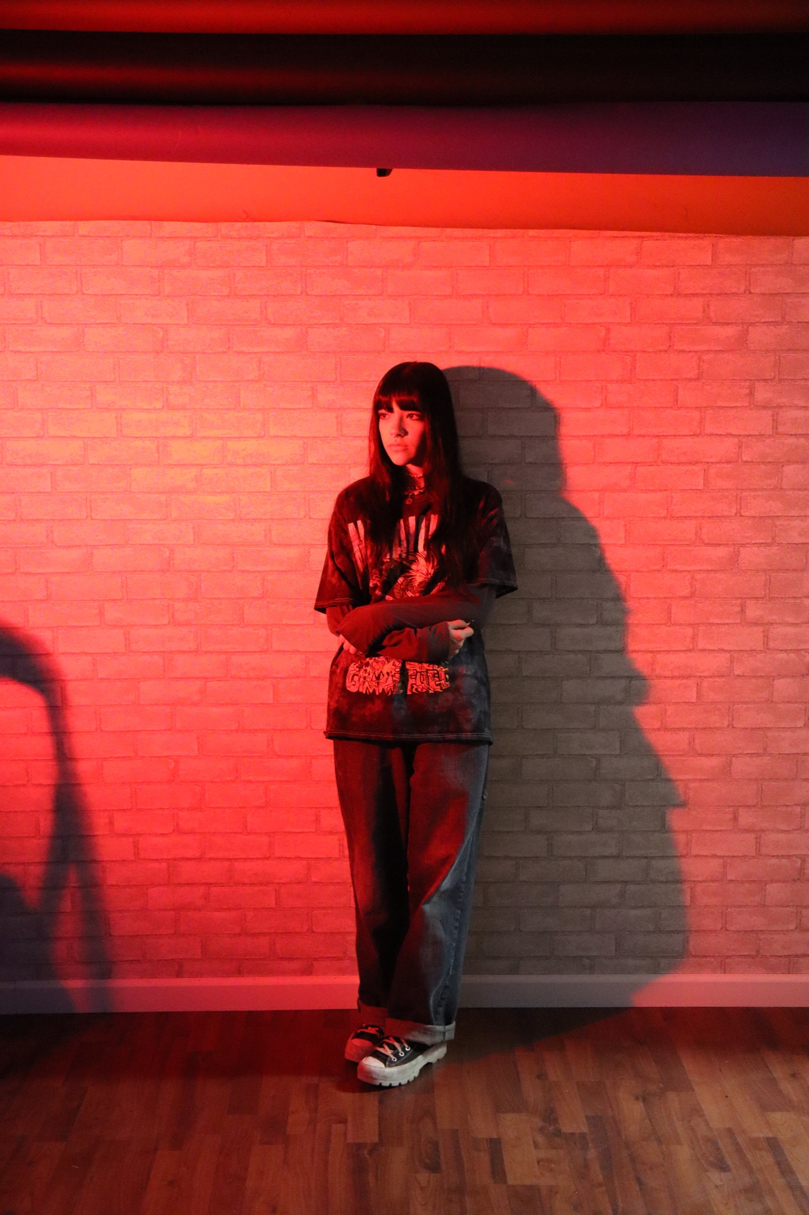
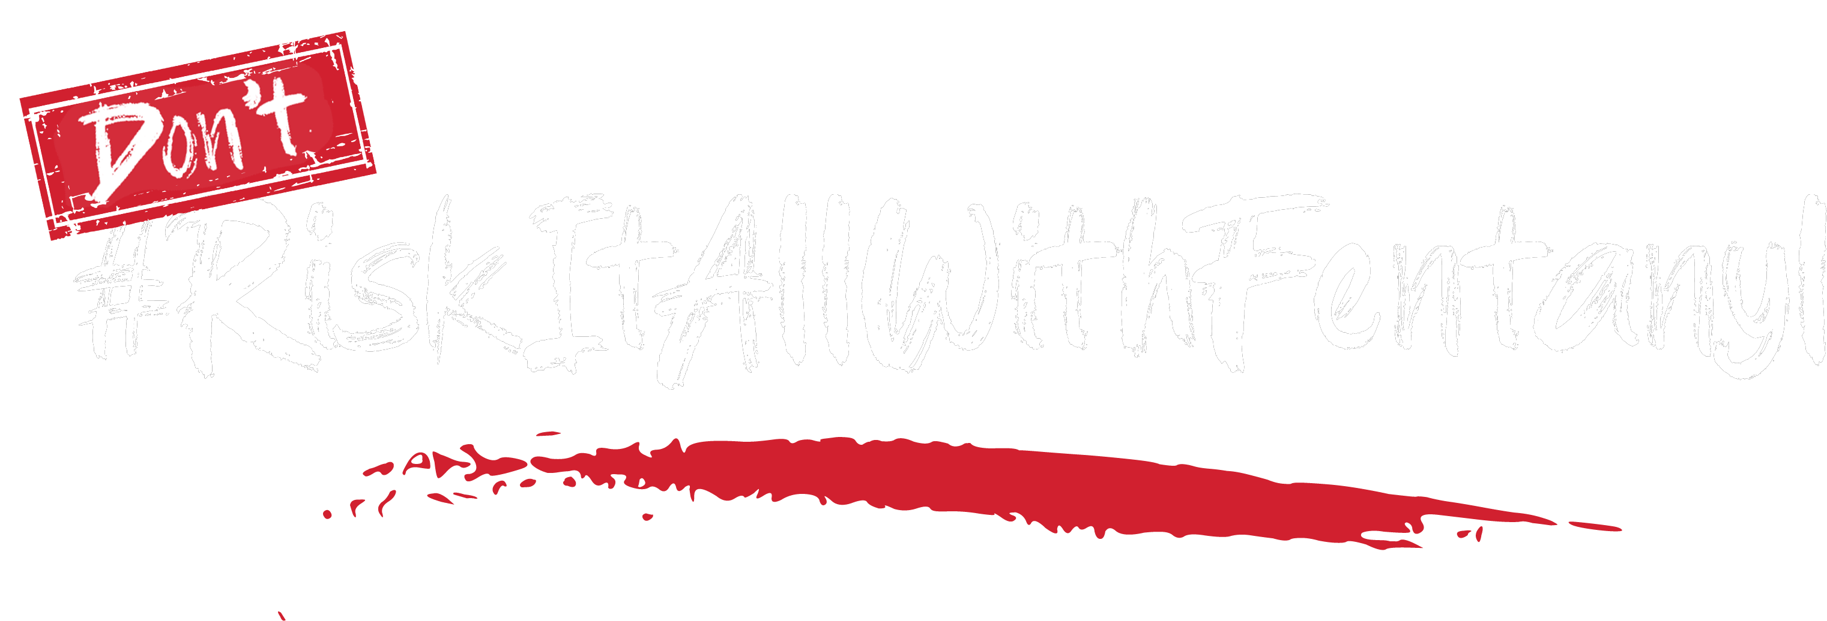
Discussion
Notes:
(Open discussion/brainstorming)
I love hearing all of these ideas!
Please let me know how I can support you in making these things happen.

Slide 21

I Pledge To:
Learn all I can!
Share what I learn!
Work together to
save lives!
Notes:
Well, we are done here today – but I hope you will join me in committing to the following:
Learn all you can
Share all you learn
Work together to save lives.
Lastly, there is power and healing in sharing our stories, to honor those we’ve lost and to help others understand the true dangers of this drug. If you would like to add your experience, photos, or memories, you can do so on the website - RiskItAllWithFentanyl.com.
Thank you!

