Slide 1
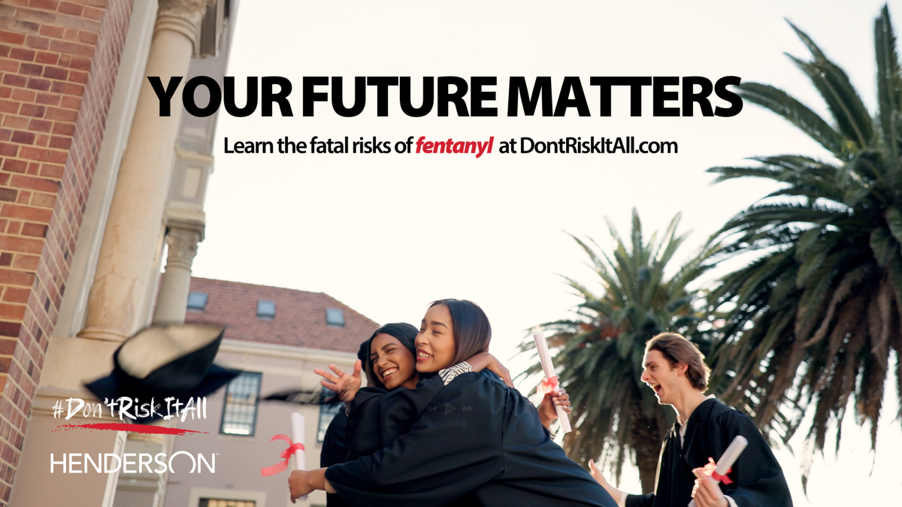

Slide 2

Train the Trainer Guide
Welcome to the "Train the Trainer" guide for the #DontRiskitAll Awareness Campaign!
This guide is specifically tailored to equip you with the necessary knowledge and skills to effectively educate your peers about the dangers and risks associated with fentanyl, a potent synthetic opioid that is increasingly causing deaths among our youth.
By becoming a trained facilitator, you can make a significant impact in raising awareness, preventing fentanyl-related harm, and saving lives.

Slide 3
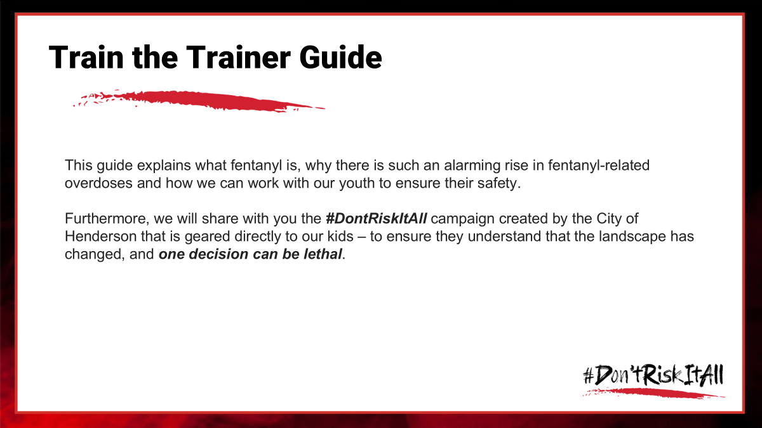

Slide 4
Why is this important?
Opioid addiction is a public health crisis caused increasingly by the addition of Fentanyl to the illicit drug market. Today, although fatal opioid overdoses are down nationally, Southern Nevada rates remain high, along with an increase in non-fatal overdoses. According to the Southern Nevada Health District, fentanyl-involved overdose deaths increased 699.83% among Clark County residents from 2018-2024. It is 50-100 times more potent than morphine and heroin!
Increasingly, we are seeing deaths among young people. And unlike most opiates, Fentanyl can be lethal with the first use. It only takes a two-milligram dose, similar to 5-7 grains of salt to cause death for an average size adult.
You can’t taste, smell or see the difference between fake pills laced with deadly Fentanyl and the real thing.
The City of Henderson desires to focus its efforts on middle school and high school-age children because youth at this age have a natural propensity to experiment, the same as every generation before them.
However, the danger of this drug makes one choice potentially lethal.

Slide 5
Why is this important?
Fentanyl is being added to almost every pill conceivable, creating fake ones with the same texture, smell and taste as the original pill. Illicit drug manufacturers are even counterfeiting everyday medicines like Tylenol and Ritalin.
And predominantly, dealers are connecting with kids on social media.
So that is where we want this campaign to show up – so hopefully we can let them know the dangers before they try it “just this one time.”
The landscape has changed. And kids of every background, zip code and socio-economic class are dying from this lethal drug.

Slide 6
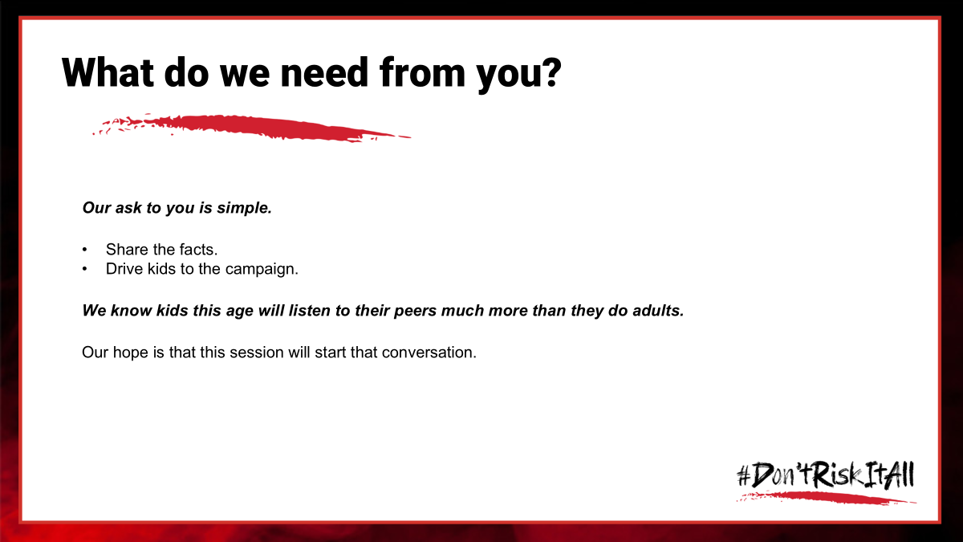

Slide 7
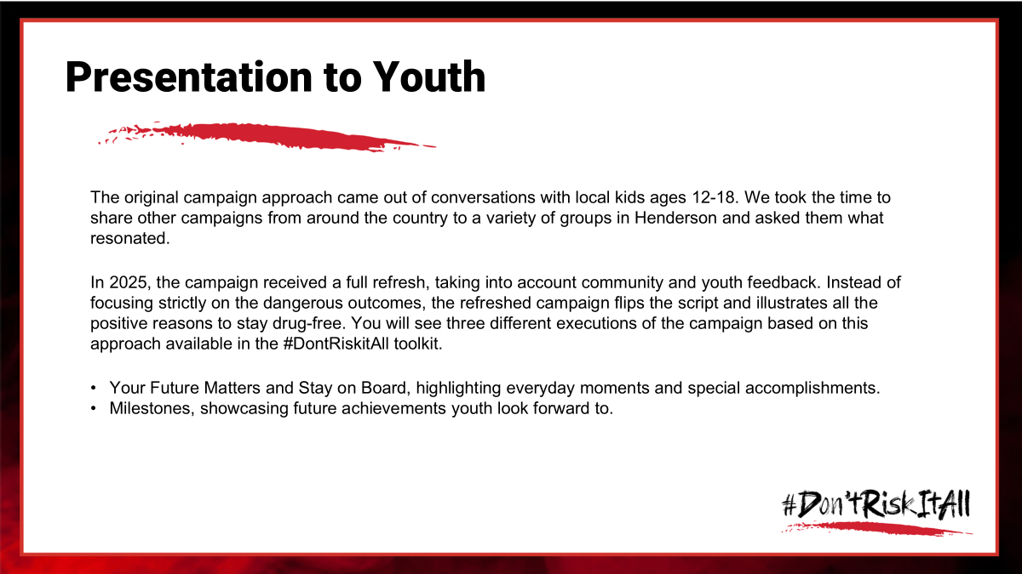
Why is this important?
Opioid addiction is a public health crisis caused increasingly by the addition of Fentanyl to the illicit drug market. Today, although fatal opioid overdoses are down nationally, Southern Nevada rates remain high, along with an increase in non-fatal overdoses. According to the Southern Nevada Health District, fentanyl-involved overdose deaths increased 699.83% among Clark County residents from 2018-2024. It is 50-100 times more potent than morphine and heroin!
Increasingly, we are seeing deaths among young people. And unlike most opiates, Fentanyl can be lethal with the first use. It only takes a two-milligram dose, similar to 5-7 grains of salt to cause death for an average size adult.
You can’t taste, smell or see the difference between fake pills laced with deadly Fentanyl and the real thing.
The City of Henderson desires to focus its efforts on middle school and high school-age children because youth at this age have a natural propensity to experiment, the same as every generation before them.
However, the danger of this drug makes one choice potentially lethal.

Slide 8
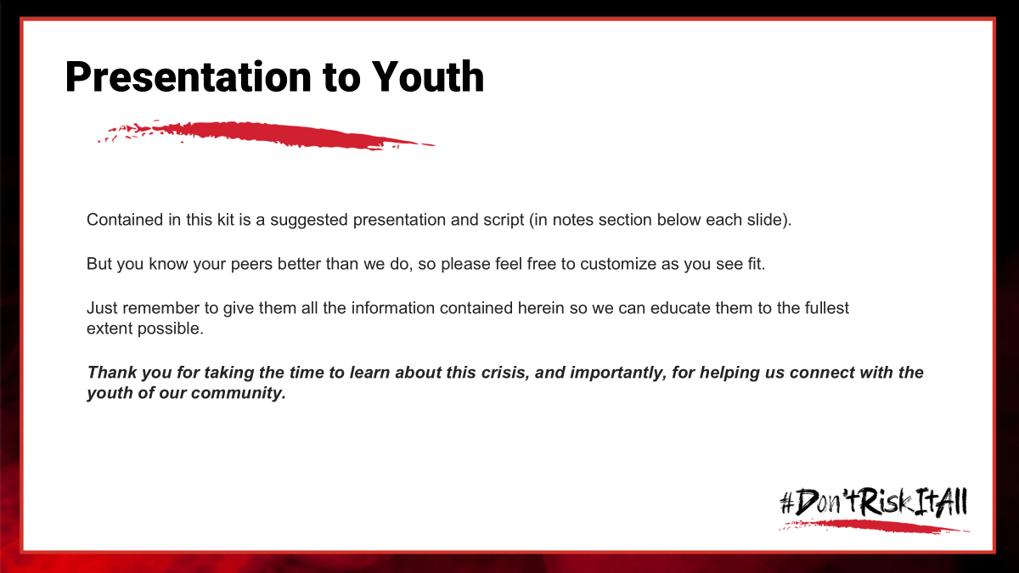

Slide 9

Notes:
Thank you for joining us today as we discuss a really important topic.
Who here today has heard of Fentanyl? (Show of hands)
For those who have, what do you know about it?
Does anyone have personal experience with this they would be willing to share?
Has anyone been offered something via social media or witnessed someone else being offered something that could be potentially dangerous?
(Allow discussion – validate accurate information, let them know we will go into more depth on topics, as needed)
Thank you for sharing and being so raw and honest.

Slide 10
How this effort started?
The addition of fentanyl to the illicit drug market has created a public health crisis, and more young people are losing their lives from just one mistake. Nevada teens are 17% more likely to use drugs than other teens in the country, which means your friends and family are at risk.
Of the deaths involving opioids, just 35% of decedents had documented opioid use history – which means the majority of youth who died were experimenting just one time, or friends and families did not know of their drug use.
While there are campaigns warning about fentanyl, we did not find any efforts directly speaking to youth. The City of Henderson received opioid settlement funding, and we worked with them to create a campaign that targets teens and warns them about the dangers of fentanyl.
Notes:
The flooding of illicit fentanyl in the market has created a public health crisis
Overdoses are down nationally, but not here in Las Vegas
And it is increasingly our youth who are dying
Nevada teens are 17% more likely to use drugs than other teens in the country - our friends and loved ones are so vulnerable right now.
Background on why the campaign was created:
When opioid funding became available, we wanted to do something with impact.
There were no campaigns speaking directly to youth, who are at risk.
So, we worked with the City of Henderson to create Don’t Risk It All. We began by talking to the youth in our city to find out what they best responded to.
We created an original campaign that addressed the dangers of fentanyl, and then last year, we updated that campaign to focus more on why your life matters. You will see an example of both campaigns shortly.

Slide 11

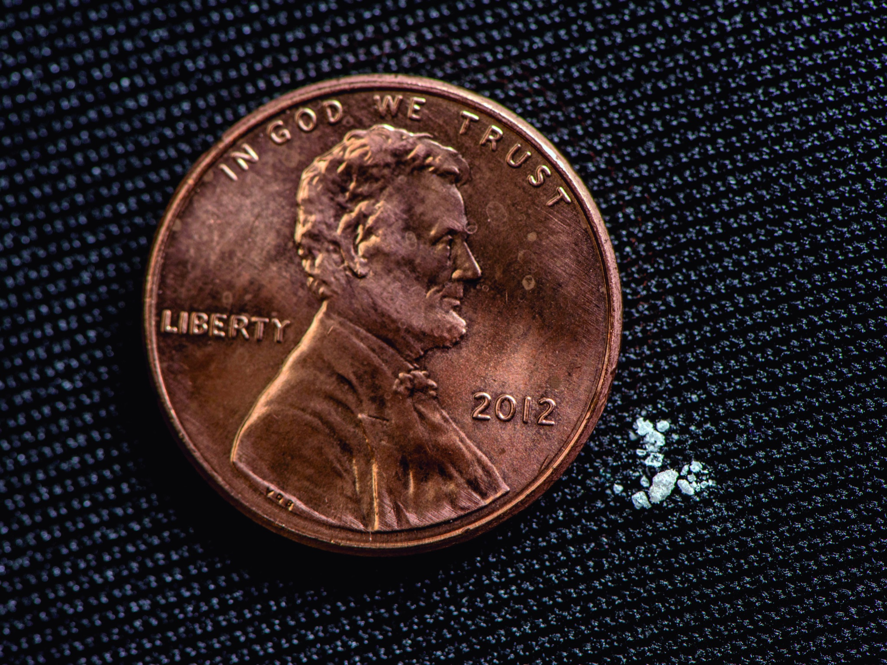
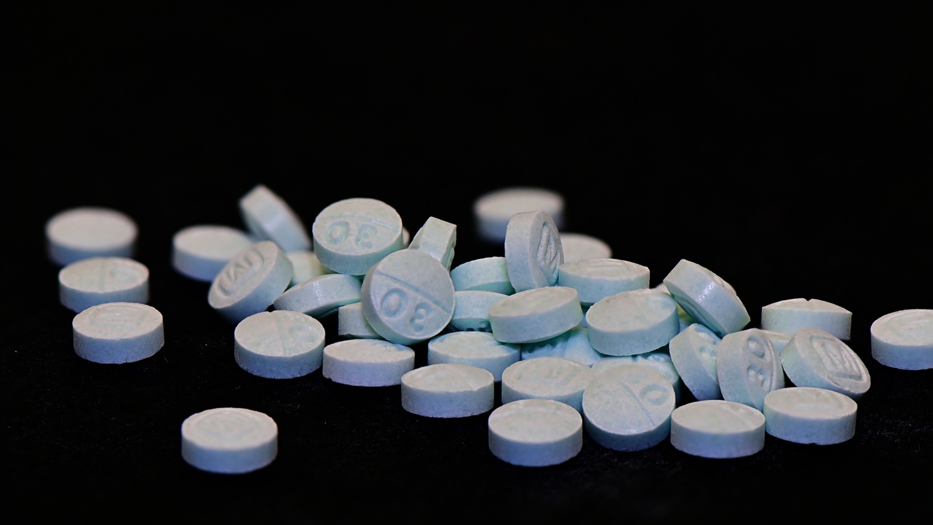
What is Fentanyl?
Notes:
First, it is important that you know that Fentanyl is creating a crisis all over the country – and especially right here in our community.
Fentanyl is a synthetic drug, originally made to treat pain. But today, it is being laced – mainly by the Mexican drug cartels - into other drugs and being sold to people without them knowing what is in it. It is super easy and really inexpensive for them to make, so it is very profitable for them.
In both 2022 and 2023, enough drugs laced with Fentanyl were seized by law enforcement to kill every American citizen. Think about that!
Fifty to 100-times more potent than morphine, Fentanyl-laced drugs have led to a 46 percent increase in deaths among people right here in Southern Nevada – in your own backyard.
Sadly, we are seeing more and more deaths among young people your age. And unlike most opiates, Fentanyl can be lethal with the first use. It only takes a two-milligram dose, similar to 5-7 grains of salt to cause death for an average size adult.

Slide 12
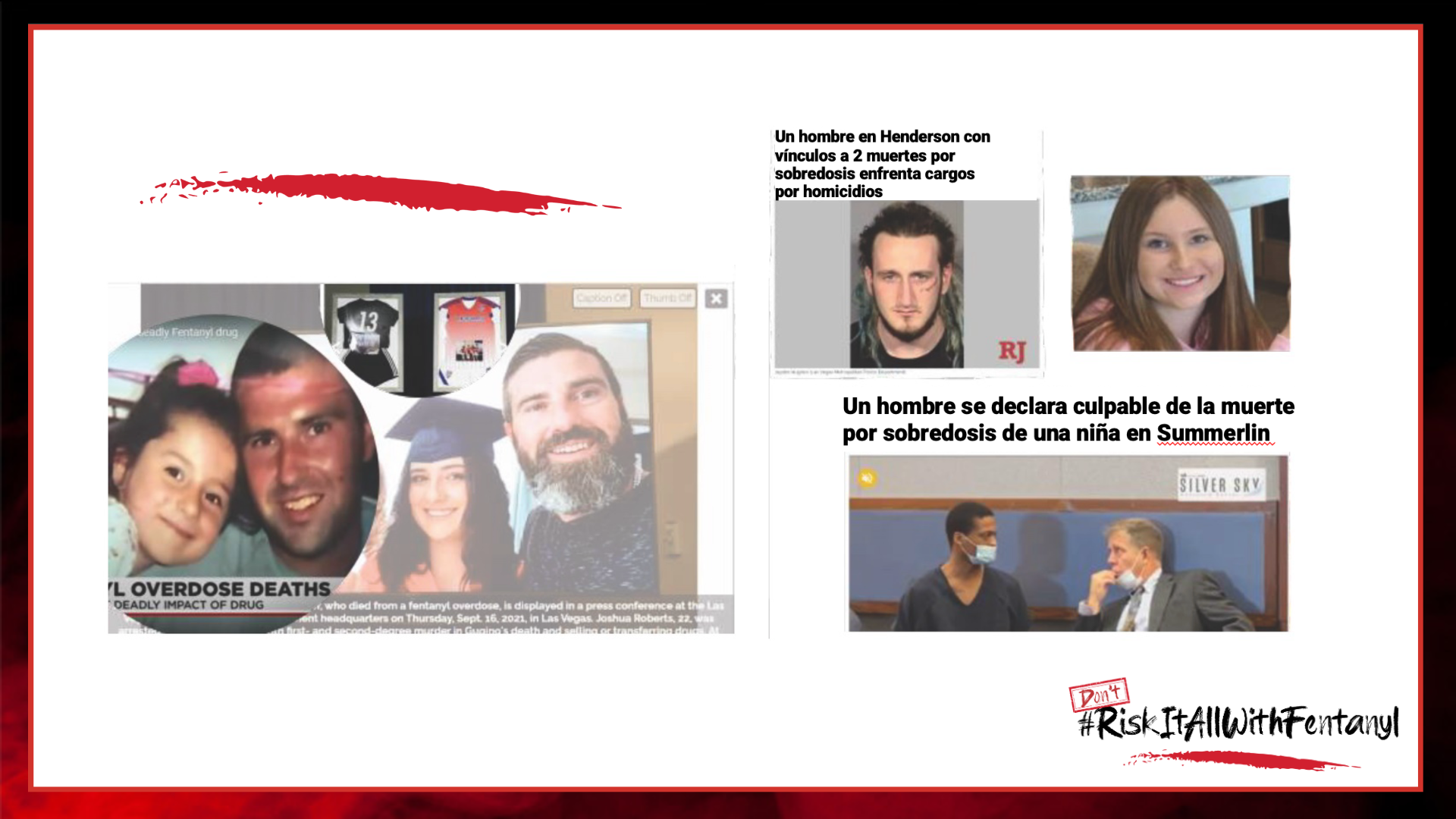

Local Headlines
Notes:
It's not just "troubled kids" who are dying - the all-too-frequent news stories show athletes, straight A students, band and drama kids losing their lives.
And it's not just happening in far-off places – high school and middle schoolers right here in Southern Nevada are affected too.
All of us were once your age – we get it.
You and your friends are likely to want to experiment – just like your parents did when they were young, and generations before them.
The problem is, the danger of this drug makes one choice potentially lethal.

Slide 13
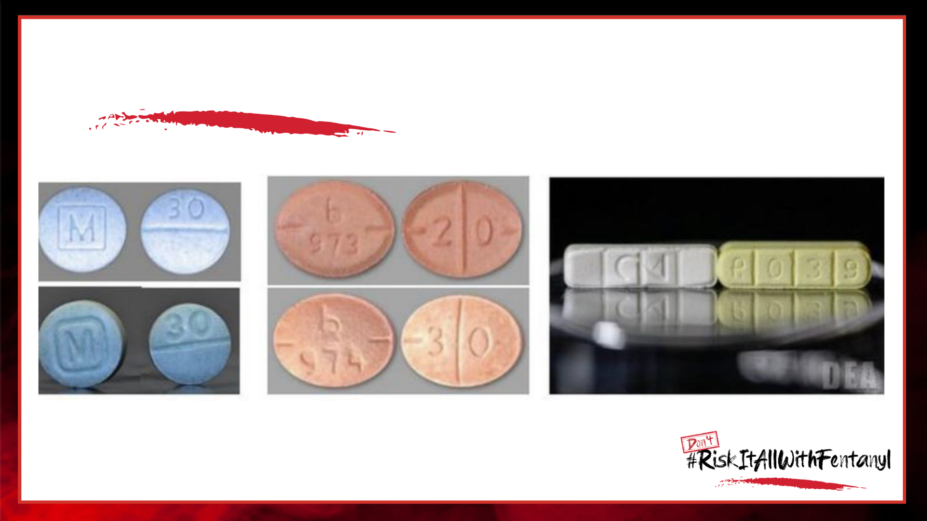
Can you tell the difference?
Notes:
Today Fentanyl is being added to almost every drug conceivable.
Street drugs like heroin and cocaine are being laced at an unimaginable rate.
Sitting here now, you might think “I’ll never take drugs, but this is a prescription pill – people take them all the time.”
The DEA estimates that 6 out of every 10 pills are fake pills laced with a lethal dose of Fentanyl. Even everyday medicines like Tylenol and Ritalin and other common drugs are being found laced with Fentanyl.
Fentanyl doesn’t change the texture, smell or taste of the pill or the powder. So, you won’t even know it’s in there until it’s too late.
Can you tell the difference?
It is also starting to pop up in other forms, like:
Liquid – mixed into drinks or vape juice
Candy – colorful and sweet-looking
Scary, huh!

Slide 14
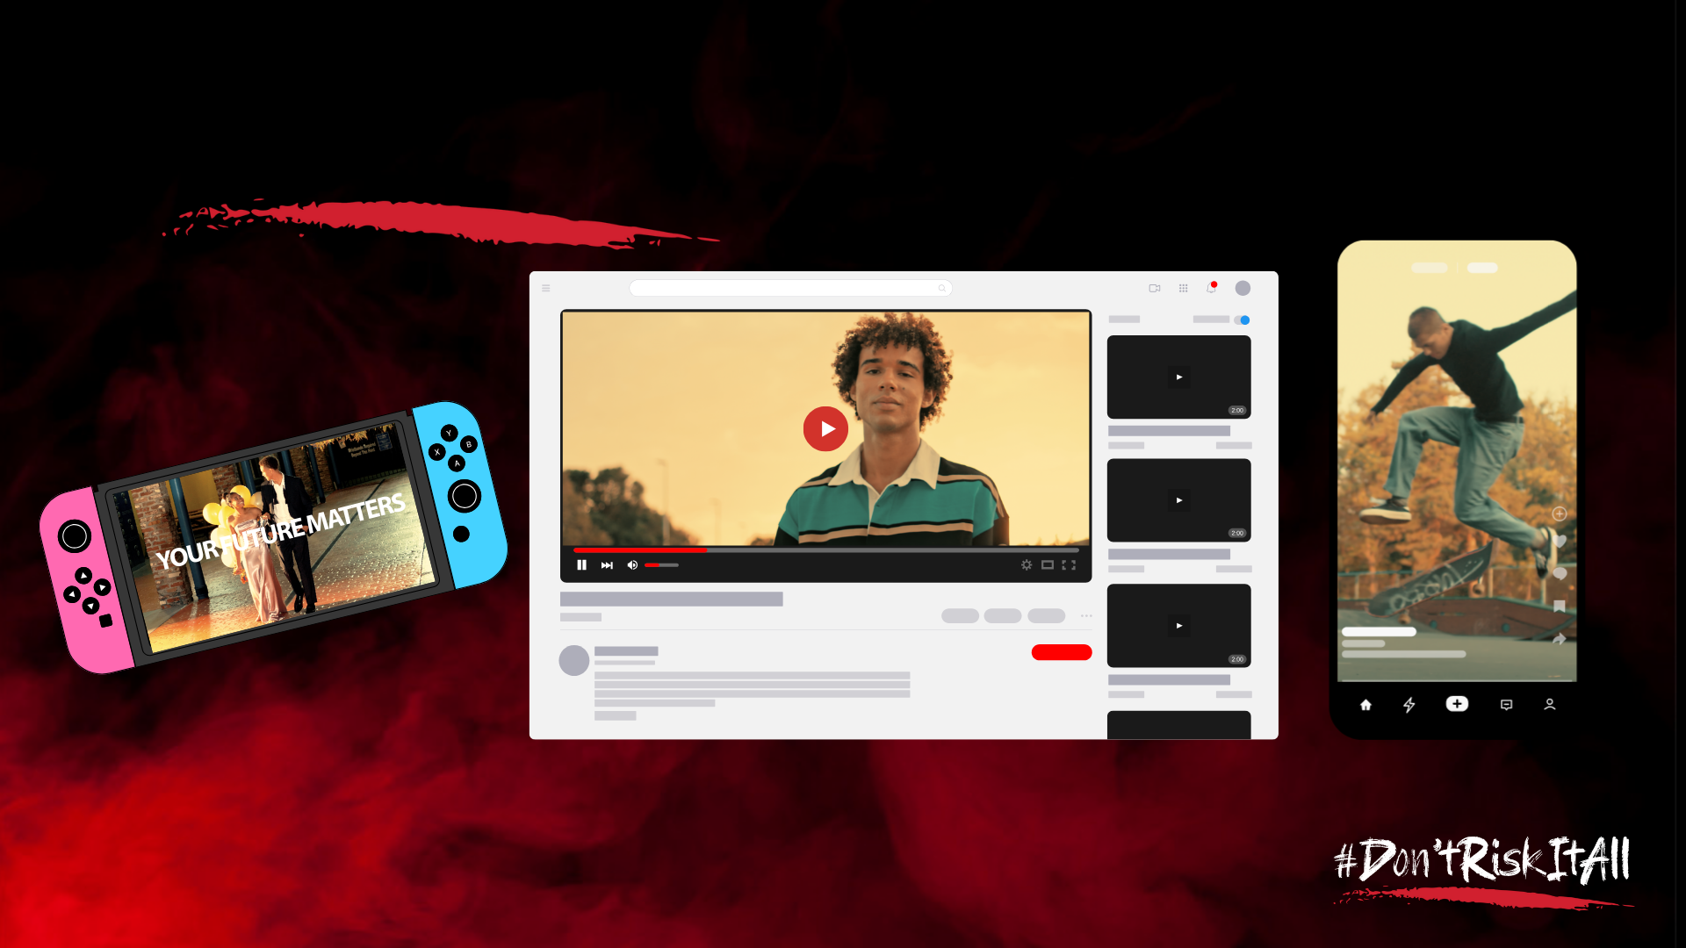
TT/YT/TikTok, YouTube and In Game Ads
Notes:
So, we feel it is really, really important that we do something to help you and your friends understand the danger that is out there.
Most often, kids are being sold these drugs through social media. People – dealers - approach them online or through apps – lure them into thinking they are getting coke, or ecstasy or some over-the-counter drug, but in reality, it has enough Fentanyl in it to kill them. The person who is selling it may not even know it is laced with Fentanyl!
So, we developed a campaign that primarily shows up online through popular apps, games and websites frequented by teens your age.
The goal is reach them before they make that one fatal decision.

Slide 15
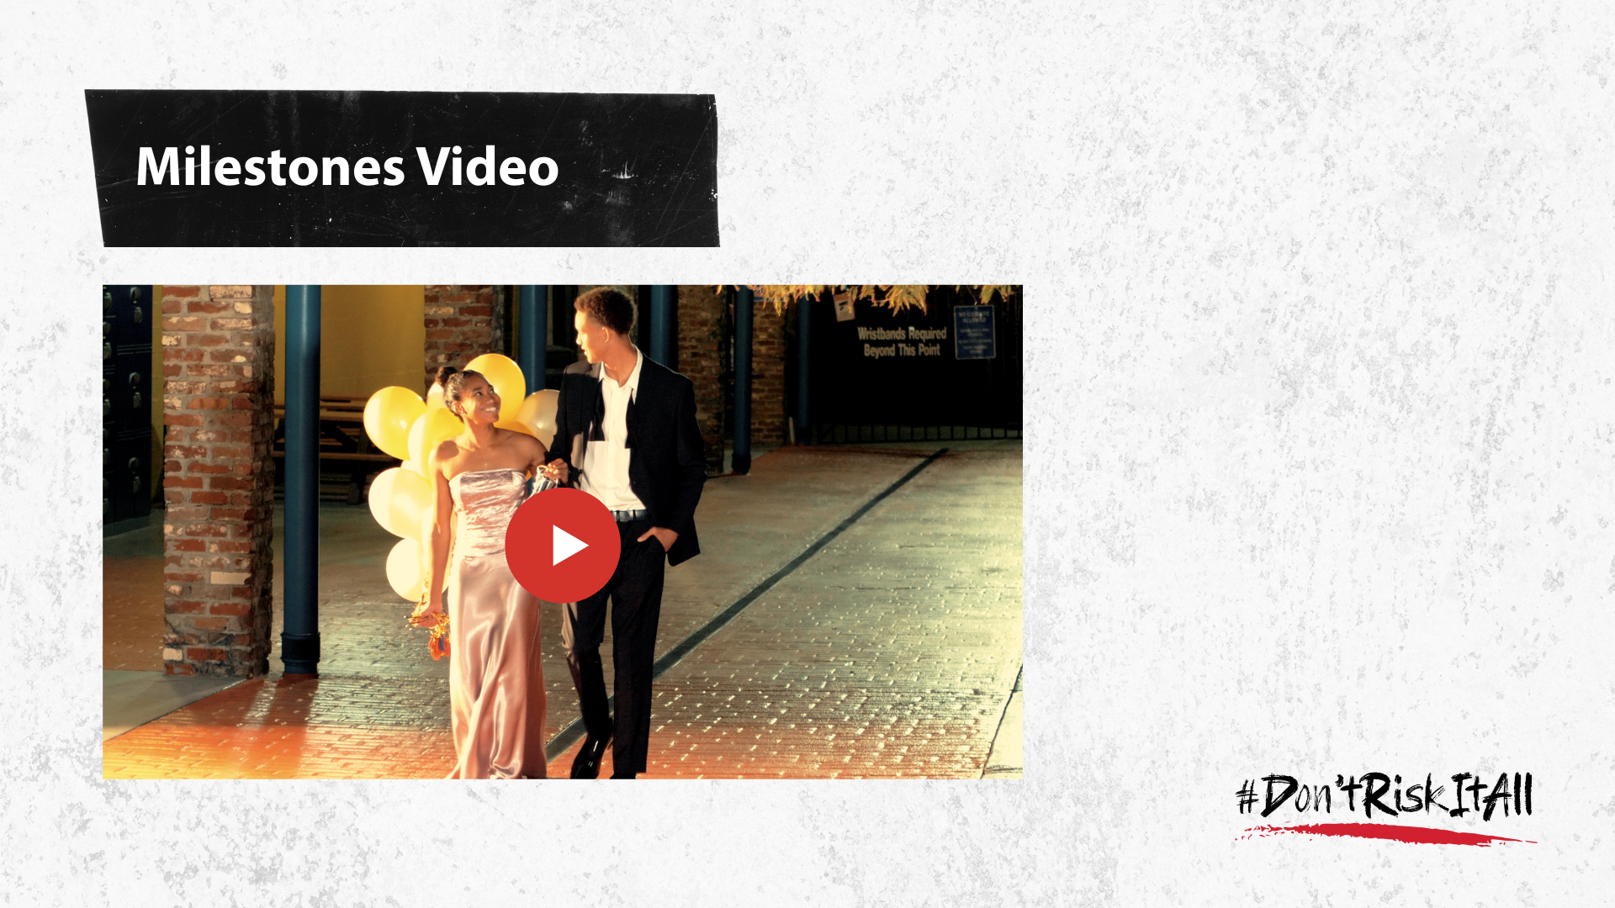
I Really Miss Him Video
VIDEO LINK
Notes:
The campaign called “Your Future Matters” flips the script and illustrates all the positive reasons to stay drug-free.
PLAY “MILESTONE” VIDEO [NEED TO EMBED VIDEO]
As you can see this version of the campaign highlights all the milestones youth have to look forward to.

Slide 16
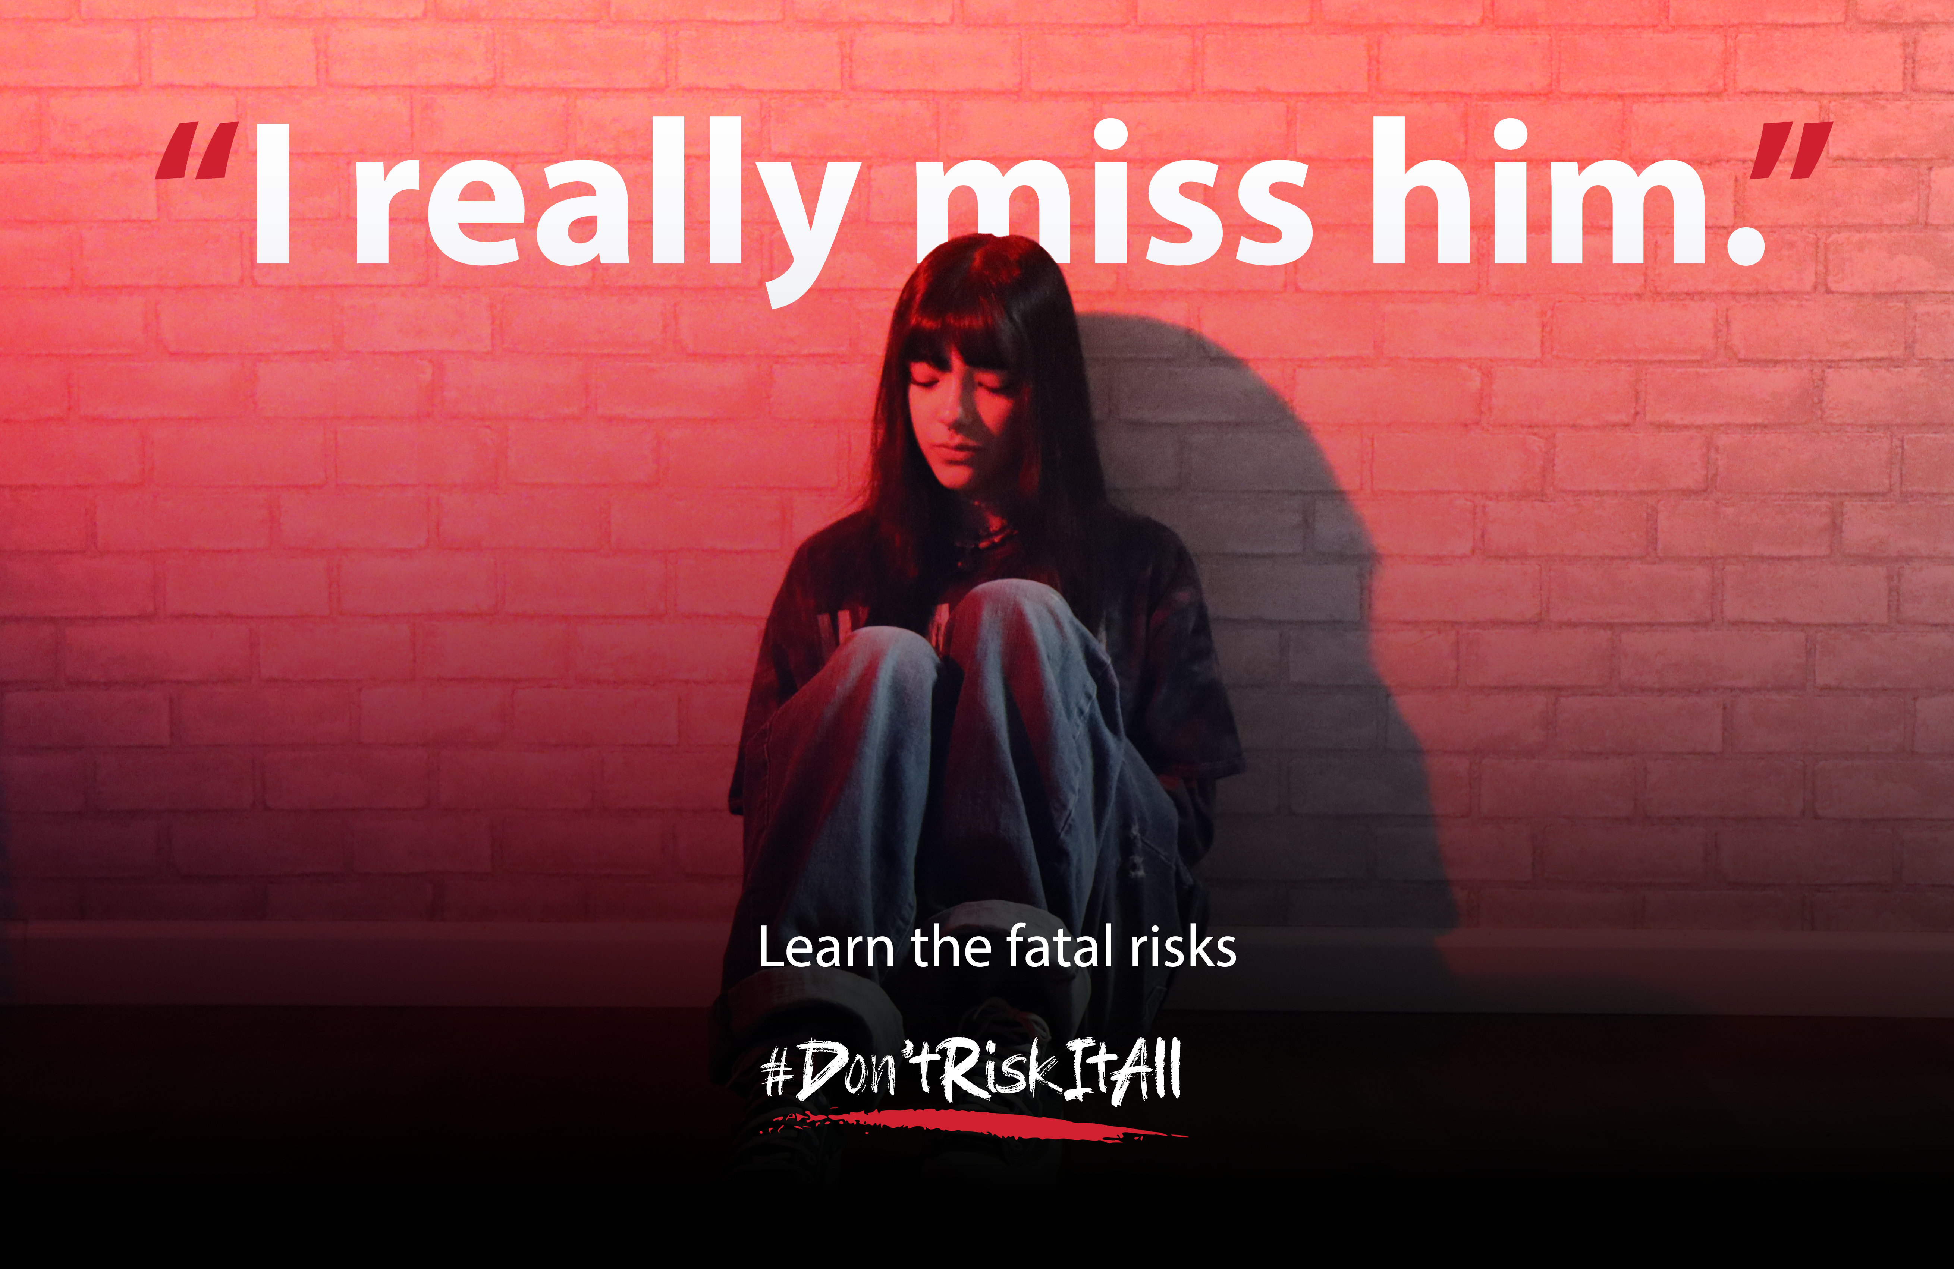
I Really Miss Him Video
VIDEO LINK
Notes:
For the original campaign, we heard from kids that there are three different approaches needed to capture their attention so hopefully they hear this information before it’s too late.
A cinematic approach with high-quality graphics and dramatic music.
A straightforward approach with direct facts.
And a story from someone their age that is local and they could relate to.
All three versions are available on the website, but today we want to share Valentina’s story.
PLAY “I REALLY MISS HIM” VIDEO
What are your thoughts about what you have seen in these videos? (open discussion)

Slide 17

Website
Notes:
On the website, we have two toolkits that contains the videos you just saw, as well as some that are sized for a variety of social media platforms.
(Give them a tour. Click the hyperlinked title to easily pull up the website or www.DontRiskItAll.com).
There also are social media graphics, posters, fliers, even TV and radio spots and banner ads.
These are all available free to anyone who wants to use them.

Slide 18
How Can You Help?
Use the social media videos
Activate the campaign in your school, at your places of worship, with your sports team or other community group
        Posters
School TV/Newspaper/Morning Announcements
Student Club
Other Ideas?
Notes:
So, this is where we need your help.
In our focus groups, it became clear that kids in junior high and high school consider what they hear from their peers much more credible than anything they hear from adults (we actually already knew that 😊)
So, we are here today because we need your help in spreading this message.
____________________________
Here’s what we would love to ask you to do:
Use the provided social assets to share this super important message with your friends and social networks.
Think about how we can activate this campaign in your school, your places of worship, sports team or other community group.
Can we hang posters around?
Can we use the ads in your school TV or newspapers?
Is there a way to incorporate this campaign into a school assembly?
Is there a student club that would want to take up Fentanyl awareness as one of their service projects?
We are open to every idea you have.

Slide 19

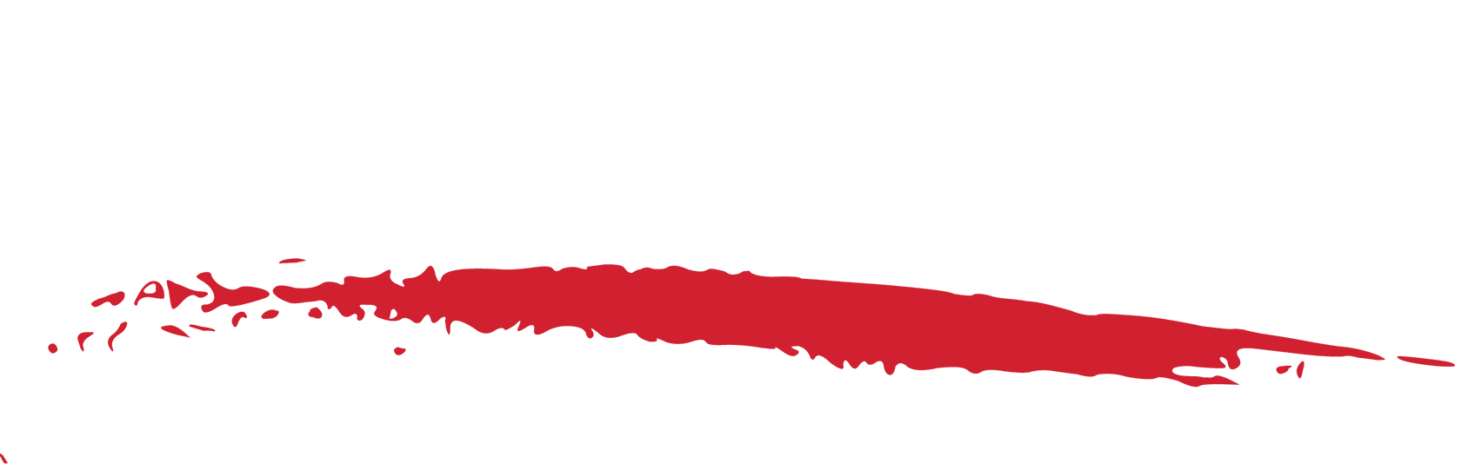



Discussion
Notes:
(Open discussion/brainstorming)
I love hearing all of these ideas!
Please let me know how I can support you in making these things happen.

Slide 20


I Pledge To:
Learn all I can!
Share what I learn!
Work together to
save lives!
Notes:
Well, we are done here today – but I hope you will join me in committing to the following:
Learn all you can
Share all you learn
Work together to save lives.
Lastly, there is power and healing in sharing our stories, to honor those we’ve lost and to help others understand the true dangers of this drug. If you would like to add your experience, photos, or memories, you can do so on the website - www.DontRiskItAll.com.
Thank you!

